Slide 1
Talking About Healthy Sex
A guide for Case Managers and Community Educators

Slide 2
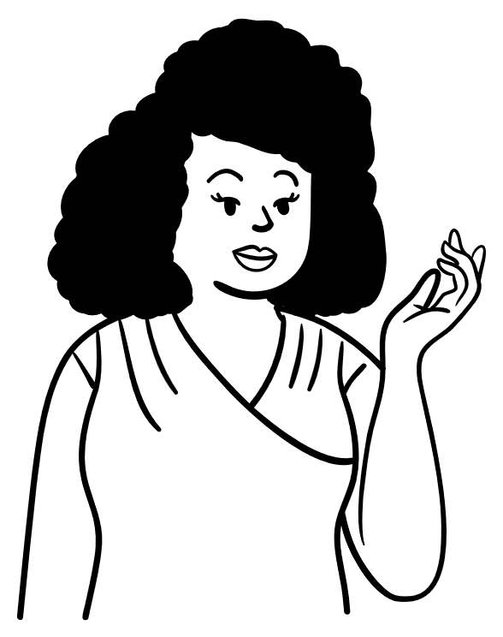
Sex has a big impact on our well-being. Talking about sex is avoided a lot of the time in doctors’ offices.
NOT talking about SEX
can be harmful
A “sexual health history” allows for testing and treating infections. But talking about healthy sex should go further!

Slide 3
What is
healthy
sex?
Safe
Consensual
Talking freely
Liberating
No shame
Pleasure focused
Empowering

Slide 4
How you define healthy sex is personal! But it is an important part of your health. We should aim for a
curious,
positive, &
respectful
approach to sexuality.

Slide 5
Mental
Physical
Emotional
Social
What is
sexual
health?
Sexual Health = Health

Slide 6
Why does Sexual Health matter?
Informs healthy relationships
Secures self-identity
Increases STI prevention and treatment
Promotes choice in sexual practices
Improves sexual satisfaction and pleasure
Notes:
https://www.who.int/health-topics/sexual-health#tab=tab_1

Slide 7
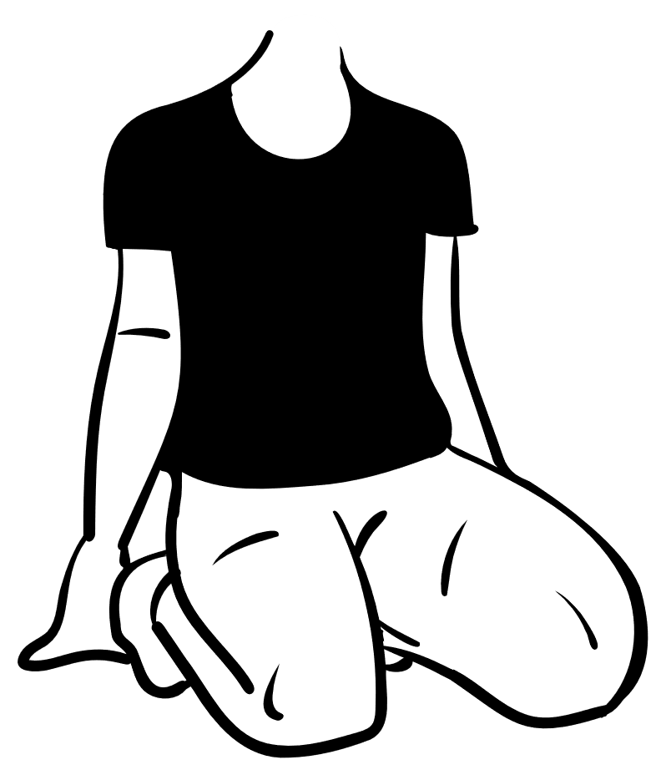
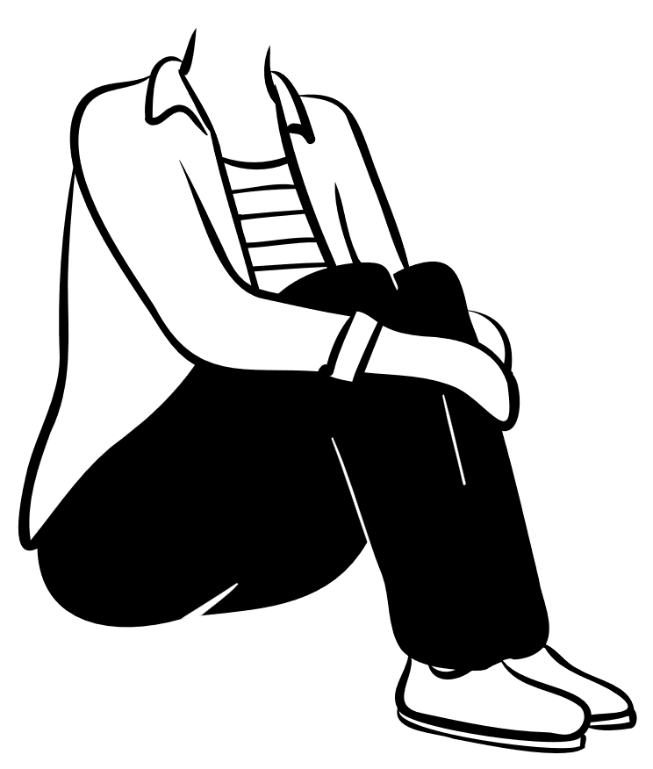
Why talk about sex?
Many people don't think to talk about sex with their patients.
You might be the only person who talks to them about their sexual habits and health!
By starting the conversation, you can create a space that encourages pleasure, healthy sex, and reduces stigma and sexual violence
Notes:
Sexual health (who.int)

Slide 8
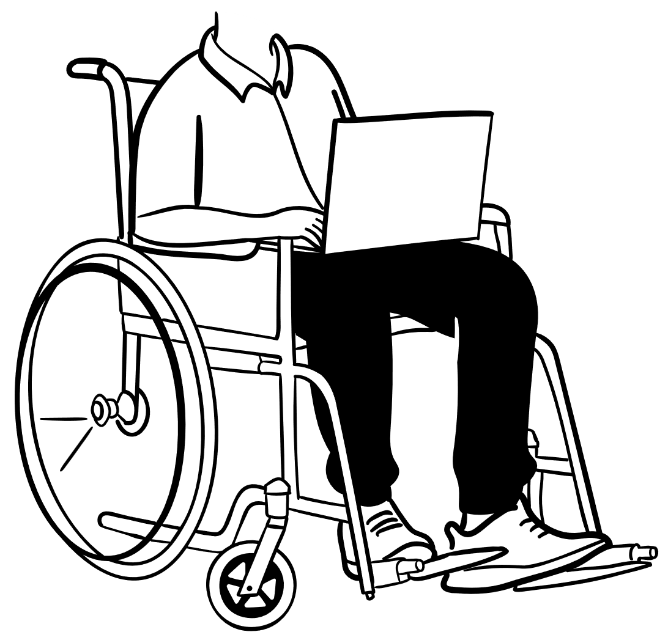
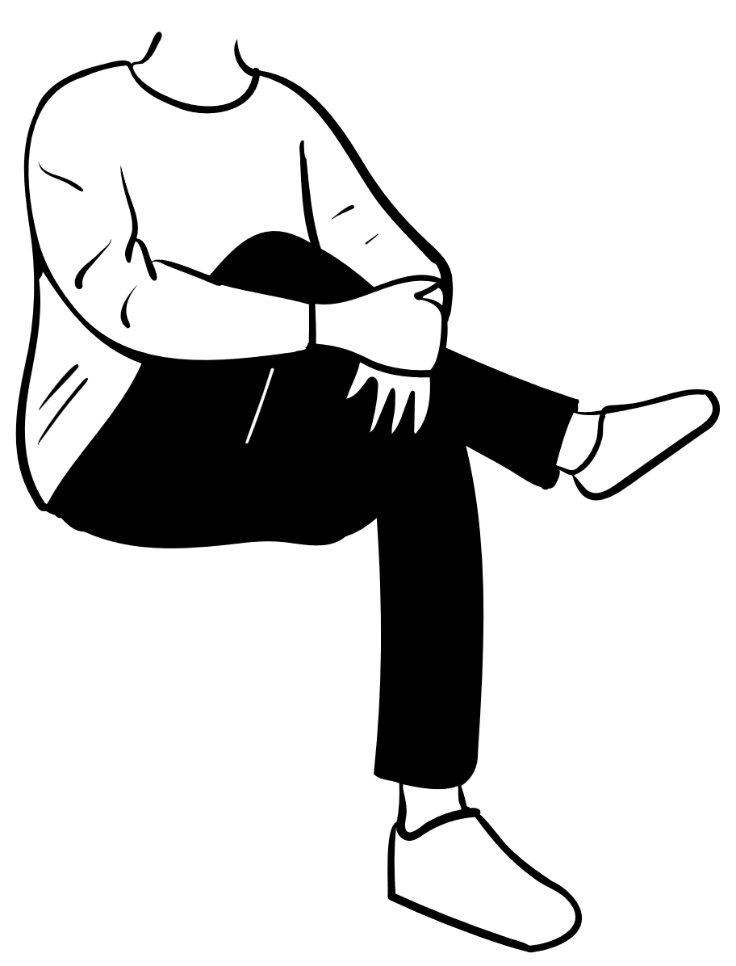
HEALTHY SEX IS A RIGHT.
LET’S START TALKING ABOUT IT.

Slide 9
So…where to start?
Not saying anything can actually say a lot!
Talking about sex doesn't have to be formal. Start small! Ask open-ended questions during everyday activities (in the car, at the salon, on a walk).
Think about your own beliefs about sex and what it means to you. This will help you be more open to other people's beliefs!
Learn about common sexual experiences. Check out resources that are available for you and others in your community. Knowing more can make you feel more confident!

Slide 10
Language is Important!
Instead of this…
Try this!
Are you married? Do you have a boyfriend?
Is there anyone special in your life?
Are you having sex?
How do you feel about your sex life?
Do you use condoms?
How comfortable does it feel to talk to your partner about [condoms, PrEP, STI testing, etc]?
Notes:
Altarum Institute. 2016. https://nationalcoalitionforsexualhealth.org/tools/for-healthcare-providers/document/ProviderGuide.pdf. Accessed January 12, 2021

Slide 11
Language is important!
Instead of this…
Try this!
Any oral/ anal sex?
What parts of your body do you enjoy using during sex?
Are you straight?
Do you have sex with men, women, or both?
Does your partner cheat on you?
Do you or your partner
have other partners?
Notes:
Centers for Disease Control and Prevention (CDC). A Guide to Sexual History Taking. 2005. http://www.cdc.gov/std/treatment/SexualHistory.pdf. Accessed January 12, 2021.

Slide 12
The 5 P’s of sexual health:
Partners
Clinicians might use this guide to talk about sex… but don’t forget the 6th P!
Practices
Protection (STIs)
Past History [of STIs]
Pregnancy Intention
Notes:
1. Centers for Disease Control and Prevention (CDC). A Guide to Sexual History Taking. 2005. http://www.cdc.gov/std/treatment/SexualHistory.pdf. Accessed January 12, 2021. 2. Altarum Institute. 2016. https://nationalcoaltionforsexualhealth.org/tools/for-healthcare-providers/documents/ProviderGuide.pdf. Accessed January 12, 2021.

Slide 13
The 6th P: Pleasure
People often don't talk about pleasure, but it's important and everyone has a right to it. Talking about pleasure can help us start conversations about relationships, how our bodies work, feeling happy, and staying safe.
What questions about sexual pleasure do you have?
What might help you and your partners focus on satisfaction?
Do you feel comfortable talking to your partner(s) about pleasure?
Altarum Institute. 2016. https://nationalcoalitionforsexualhealth.org/tools/for-healthcare-providers/document/ProviderGuide.pdf. Accessed January 12, 2021.

Slide 14
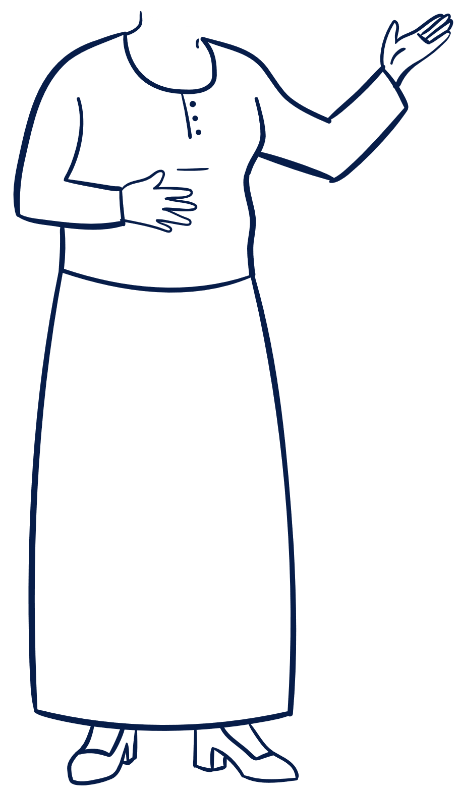
The 6th P: Pleasure
Many people think that focusing on pleasure becomes less important as we get older. But that's not true. Sexuality and sexual expression continue even as we age. No matter how the age, all adults have the right to enjoy their sexual experiences!

Slide 15
Ideas for talking about sex
Be okay with not always knowing what to say.
Be supportive and don't judge others.
Don’t assume things like preferences, sexual orientation, or gender identity.
Focus on understanding and respecting cultural differences.
Be aware of your body language and facial expressions – you can practice in the mirror!
Keep an open mind.
Know your strengths and limits.
Be open. Be present. Be respectful.
verbal and body language matter.

Slide 16
Resources
GAY, LESBIAN, BISEXUAL, AND TRANSGENDER INDIVIDUALS
National LGBT Health Education Center
Suggested Resources and Readings
American Medical Association
LGBT Resources
University of California, San Francisco
Center of Excellence for Transgender Health
World Professional Association for Transgender Health
Standards of Care
MALES
Male Training Center for Family Planning and Reproductive Health
Preventive Male Sexual and Reproductive Health Care: Recommendations for Clinical Practice
The Partnership for Male Youth
Health Provider Toolkit for Adolescent and Young Adult Males
OLDER ADULTS
National Institute on Aging
Talking with Your Older Patient: A Clinician’s Handbook
Clinical education & resources on specific health topics
FAMILY PLANNING/CONTRACEPTION
Centers for Disease Control and Prevention
US Selected Practice Recommendations for Contraceptive Use, 2013
United States Medical Eligibility Criteria (US MEC) for Contraceptive Use, 2016
Providing Quality Family Planning Services
HIV AND PRE-EXPOSURE PROPHYLAXIS (PREP)
Centers for Disease Control and Prevention
Recommendations for HIV Prevention with Adults and Adolescents with HIV in the United States, 2014:
Summary for Clinical Providers PrEP Guidelines PrEP Clinical Provider Supplement
SEXUAL FUNCTIONING
Association of Reproductive Health Professionals
Handbook on Female Sexual Health and Wellness
American Congress of Obstetricians and Gynecologists
Finding Solutions for Female Sexual Dysfunction
SEXUALLY TRANSMITTED INFECTIONS
Centers for Disease Control and Prevention
Sexually Transmitted Diseases Treatment Guidelines, 2015
STD Webinars
Self-Study STD Modules for Clinicians
National STD/HIV Prevention Training Centers
Online Case Series
VIRAL HEPATITIS
Centers for Disease Control and Prevention
Viral Hepatitis Serology Training
Other clinical resources
TAKING A SEXUAL HISTORY/DISCUSSING SEX WITH PATIENTS
American Medical Association
Patient Sexual Health History: What You Need to Know to Help
Centers for Disease Control and Prevention
A Guide to Taking a Sexual History
Cardea
Sexual History-Taking Toolkit
Association of Reproductive Health Professionals
Talking With Patients about Sexuality and Sexual Health
Altarum Institute. 2016. https://nationalcoalitionforsexualhealth.org/tools/for-healthcare-providers/documents/ProviderGuide.pdf. Accessed January 12, 2021.

