Slide 1
UNDERSTANDING AGING
A guide for Case Managers and Community Educators

Slide 2
Aging with hiv¹
As medical advancements have improved, people living with HIV are living longer, healthier lives. This means that there is a growing population of older adults living with HIV.¹ After decades of fear, loss, and heartache, this is something we all can celebrate.
However, this shift presents new challenges and chances for us to learn. Understanding the unique challenges and considerations of this demographic is important for providing compassionate care.
1. American Academy of HIV Medicine. HIV and Aging. Available at: https://aahivm.org/hiv-and-aging/. Accessed April 9, 2025.

Slide 3
Demographics of Older Adults with HIV
“Demographics” are statistics that describe different characteristics of a group of people. These characteristics include things like age, gender, race, income, education level, and where people live.
The demographics of people living with HIV (PLWH) are changing: in 2021, 41% of people living with HIV in the U.S. were aged 55 and older.¹
Around 16% of new HIV diagnoses in 2023 were in people aged 50 or older.²​
These demographics highlight the importance of having age-specific care and support.​
AIDSVu. National HIV/AIDS and Aging Awareness Day 2023. Available at: https://aidsvu.org/news-updates/national-hiv-aids-and-aging-awareness-day-2023/. Accessed April 9, 2025.
HIVinfo.NIH.gov. National HIV/AIDS and Aging Awareness Day. Available at: https://hivinfo.nih.gov/understanding-hiv/hiv-aids-awareness-days/national-hiv-aids-and-aging-awareness-day. Accessed April 9, 2025.

Slide 4
Late Diagnosis in Older Adults¹
A concerning trend is the increasing number of advanced HIV diagnoses among older adults..
In 2022, 33% of individuals aged 55 and older were diagnosed with advanced HIV (AIDS)¹
Some health care providers don’t test for HIV and older people may think HIV symptoms are just normal parts of aging so they don’t consider HIV as a reason for their symptoms.¹
What does this mean?
It suggests that HIV testing is not happening early and often enough in this demographic. People assume that older adults do not have sex, which is not true! It is safer to assume everyone has some type of sex to avoid delayed diagnoses, treatments, and poorer health outcomes.
Routine testing for HIV is important to help prevent this from happening.
1. HIV.gov. Aging with HIV. Available at: https://www.hiv.gov/hiv-basics/living-well-with-hiv/taking-care-of-yourself/aging-with-hiv. Accessed April 9, 2025.

Slide 5
Health Challenges of Aging with HIV
Older adults living with HIV face many of the same health concerns as their peers without HIV. Actually many of the health concerns older PLWH face are more about aging than HIV!¹ There are still some unique health considerations:
Increased risk of comorbidities ( like heart disease, diabetes, and bone thinning)²
Potential for accelerated aging processes in individuals with HIV³
Older PLWH are more likely to have other health issues, and studies show that HIV might make them age faster.³ It is important to have a healthcare team that understands how HIV can impact health and takes care of all these conditions.
Comorbidities are when a person has more than one health problem or disease at the same time. For example, someone with HIV might also have diabetes or heart disease. These extra health problems can make managing overall health more complicated.
The Well Project. Aging and HIV. Available at: https://www.thewellproject.org/hiv-information/aging-and-hiv. Accessed April 9, 2025.
American Academy of HIV Medicine. The Aging of HIV: A Growing Challenge to Health Care. Available at: https://aahivm.org/wp-content/uploads/2017/02/Aging-report-working-document-FINAL-12.1.pdf. Accessed April 9, 2025.
HIV.gov. Aging with HIV. Available at: https://www.hiv.gov/hiv-basics/living-well-with-hiv/taking-care-of-yourself/aging-with-hiv. Accessed April 9, 2025.

Slide 6
Why is antiretroviral therapy important?
Antiretroviral therapy is the medicine used to treat HIV. You may have heard it called ART, cART, or HAART. It can be pills, injections, or in some cases, a combination of pills and injections.
Antiretroviral therapy remains the cornerstone of managing HIV. For older adults, adherence to ART remains important. An effective and well tolerated ART regimen allows PLWH to achieve viral suppression.
Viral suppression helps
prevent HIV from progressing
reduce the chance of other HIV associated illnesses
enhance quality of life
reduce the risk of HIV being passed to others.¹
HIV.gov. Viral Suppression. Available at: https://www.hiv.gov/hiv-basics/staying-in-hiv-care/hiv-treatment/viral-suppression#:~:text=Viral%20suppression%20is%20defined%20as,having%20an%20undetectable%20viral%20load. Accessed April 9, 2025.

Slide 7
Mental Health in older adults living with hiv
Mental health is very important for everyone, including older adults with HIV. Among PLWH, older adults are more likely to feel depressed and anxious, which may affect their physical health and ability to manage their health conditions.
A study estimated that 28% of older PLWH have a depressive disorder¹.
It is important for care providers and educators to understand that some PLWH experience complicated trauma, grief, and loss associated with being a long-term survivor²
While there are different reasons for mental health challenges, it is important to advocate for and integrate mental health services into HIV care.​
Nyirenda et al. Prevalence of Depression in Elderly People Living with HIV. Infectious Medicine. December 2023. Available at: https://journals.lww.com/imd/fulltext/2023/12000/prevalence_of_depression_in_elderly_people_living.2.aspx#:~:text=It%20is%20reported%20that%20depressive,study%20by%20Nyirenda%20et%20al. Accessed April 9, 2025.
2. TheBodyPro. ANAC 2024: HIV Care for Geriatric Patients. Available at: https://www.thebodypro.com/hiv/anac-2024-hiv-care-geriatric-patients. Accessed April 9, 2025.

Slide 8
Social Support and Community Engagement
Older adults with HIV may experience social isolation and loneliness, which can negatively affect their mental and physical health.
One study found that social isolation and loneliness were common among older adults with HIV¹.​
Older PLWH that were depressed are more likely to experience social isolation¹
Older PLWH that were anxious or experiencing stigma were more likely to feel lonely¹
Engagement in support groups and community activities may improve quality of life through social experiences. These activities don’t have to be fancy! Any reason to be with company is a good start – things like game nights, crafting sessions, or walking groups can bring people together.
Be mindful of how some people with limited mobility may be more isolated
1. PubMed. Multivariable analyses identified that being, were associated with social isolation. Available at: https://pubmed.ncbi.nlm.nih.gov/39578382/#:~:text=Multivariable%20analyses%20identified%20that%20being,were%20associated%20with%20social%20isolation. Accessed April 9, 2025.

Slide 9
Stigma and Discrimination
Stigma is bias that comes with labeling someone as part of a group that is thought to be taboo or not okay. Discrimination is the way people are treated differently as a result of those beliefs.¹
Stigma remains a significant barrier for older adults living with HIV, often compounded by different biases. Our advocacy and education plays a vital role in dispelling myths, educating the public, and advocating for policies that promote inclusivity and support.
Older adults with HIV may face stigma, ageism, racism, ableism, and HIV-related stigma.​
Education and advocacy are key to reducing stigma and promoting inclusivity.​ It is everyone’s responsibility to stand up for what is right.
SPEAK UP! While protecting your safety is very important, be willing to be uncomfortable.
1. Centers for Disease Control and Prevention. HIV Stigma and Discrimination. CDC. https://www.cdc.gov/stophivtogether/hiv-stigma/index.html#:~:text=What%20is%20discrimination?,people%20as%20HIVers%20or%20Positives.

Slide 10
Cognitive Health and HIV
Cognitive health is our ability to concentrate, learn, plan, think, accurately remember, and reason through things¹
People may assume memory loss is a normal part of aging, but that isn’t true! There are a lot of reasons for changes in cognitive health, but, no matter the reason, it is usually very distressing for the individual and their loved ones.
Older adults with HIV may experience cognitive decline, including memory issues and decreased concentration.
Cognitive changes range greatly, including minor differences that don’t change a person’s ability to function to disabling changes that prevent someone from being able to take care of themself at all².
Regularly assessing cognitive health can help find problems early and manage them. This allows for timely actions to keep a good quality of life.
Alzheimer's Society. HIV and Cognitive Impairment. Available at: https://www.alzheimers.org.uk/about-dementia/types-dementia/hiv-cognitive-impairment#:~:text=However%2C%20many%20people%20who%20have,concentration. Accessed April 9, 2025.
National Center for Biotechnology Information. Social Isolation and Loneliness in Older Adults: Opportunities for the Health Care System. Available at: https://www.ncbi.nlm.nih.gov/books/NBK555954/. Accessed April 9, 2025.

Slide 11
Polypharmacy
Polypharmacy is taking more than 5 (non-HIV) prescription medications.¹ Non-prescribed drugs are also a concern (like over the counter, street drugs, and herbal remedies)! It is important to be aware of polypharmacy as it is common in older PLWH.
Daily long-term medications by age.² (Vertical bars represent 95% confidence intervals.)
9
8
7
6
5
Daily Long-Term Medications
4
6
7
When people have various health conditions, they often have medications to manage them. The number of medications an older PLWH takes can increase over time. The more medicines a person takes, the more potential for drug-drug interactions, which, when not managed appropriately, may have harmful effects on health.
Coordinated care among healthcare providers is crucial to prevent adverse drug interactions and make sure the treatments are working.
3
5
5
4
2
3
1
0
<40
40–50
51–60
Age (years)
seronegative, n=47,613
seropositive, n=16,324
HIVinfo.NIH.gov. HIV and Older People. Available at: https://hivinfo.nih.gov/understanding-hiv/fact-sheets/hiv-and-older-people. Accessed April 9, 2025.
PLWH, people living with HIV. Edelman EJ, et al. Drugs Aging. 2013;30(8):613–628.

Slide 12
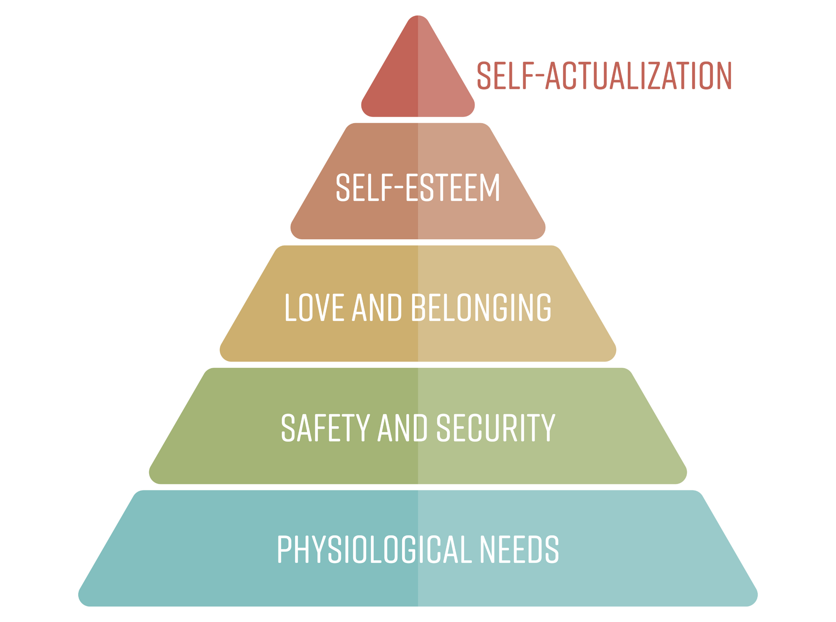
Housing and Support Services
According to Maslow, our needs are organized in a pyramid. Basic needs like food, housing, and water are at the bottom, and more advanced needs like creativity and reaching your full potential are at the top. This theory says that basic survival needs have to be met before a person can focus on higher needs.¹
Stable housing is a basic need. It positively impacts the health and well-being of older PLWH. Access to safe and affordable housing can improve health outcomes and quality of life.²
There are organizations that provide housing assistance and support services tailored to the needs of PLWH.
Be mindful that people experiencing insecure housing have basic needs that are not being met, so will often need help accessing these services.
Maslow's Hierarchy of Needs
McLeod, S. (2020). Maslow's Hierarchy of Needs. Simply Psychology. Available at: https://www.simplypsychology.org/maslow.html. Accessed April 9, 2025.
HIV.gov. Housing and Health. HIV.gov. https://www.hiv.gov/hiv-basics/living-well-with-hiv/taking-care-of-yourself/housing-and-health#:~:text=Stable%20housing%20is%20closely%20linked,due%20to%20HIV%2Drelated%20illnesses.

Slide 13
Food and exercise
Trying to eat a balanced diet and regular physical activity are essential for supporting healthy aging and strengthening the immune system in older PLWH.
Regular physical activity can help with a lot of things, not just strength! Movement should not feel like a chore, so encouraging people to find an exercise that feels good and can be done safely is important for physical and mental health. If able, take the stairs, park a little further from a store, walk in place during commercials. Little things add up when it comes to moving our bodies.
When talking to people about their diet, consider what resources people have access to, and what food may mean for them culturally and emotionally. Try to avoid assigning morality to food choices.
The Well Project. Aging and HIV. Available at: https://www.thewellproject.org/hiv-information/aging-and-hiv. Accessed April 9, 2025.

Slide 14
Preventative health care
Keeping up with regular health care is important not just for people aging with HIV, but for everyone.
There are recommendations through an organization called U.S Preventive Task Force (USPSTF) on what prevention care is needed based on age, sex assigned at birth, other conditions¹.
Vaccines and regular screenings for cancers, heart disease, and bone thinning are important parts of preventive care and something that a primary care provider can help with.
This preventive care helps in prevention and early detection of age-related conditions. Diagnosing these conditions early, enables health care teams to use timely interventions, improving health outcomes for older PLWH.
U.S. Preventive Services Task Force. Home. Available at: https://www.uspreventiveservicestaskforce.org/uspstf/home. Accessed April 9, 2025.

Slide 15
Aging well With HIV Is Possible
Diagnose HIV early and start treatment to keep a viral load suppressed
Staying engaged in care for HIV and preventive services
Encourage social engagement, physical activity, and a varied diet
Minimize polypharmacy
Use a team approach! Include social workers, occupational therapists, physiotherapists, peer navigators, support workers.

